Slide 1
Effective Resource Development: Leveraging the Continuum of Funding Strategies to Achieve your Mission
Mary Beth McIntire, MBA
Chief Programs Officer - Medical Society of Virginia

Slide 2
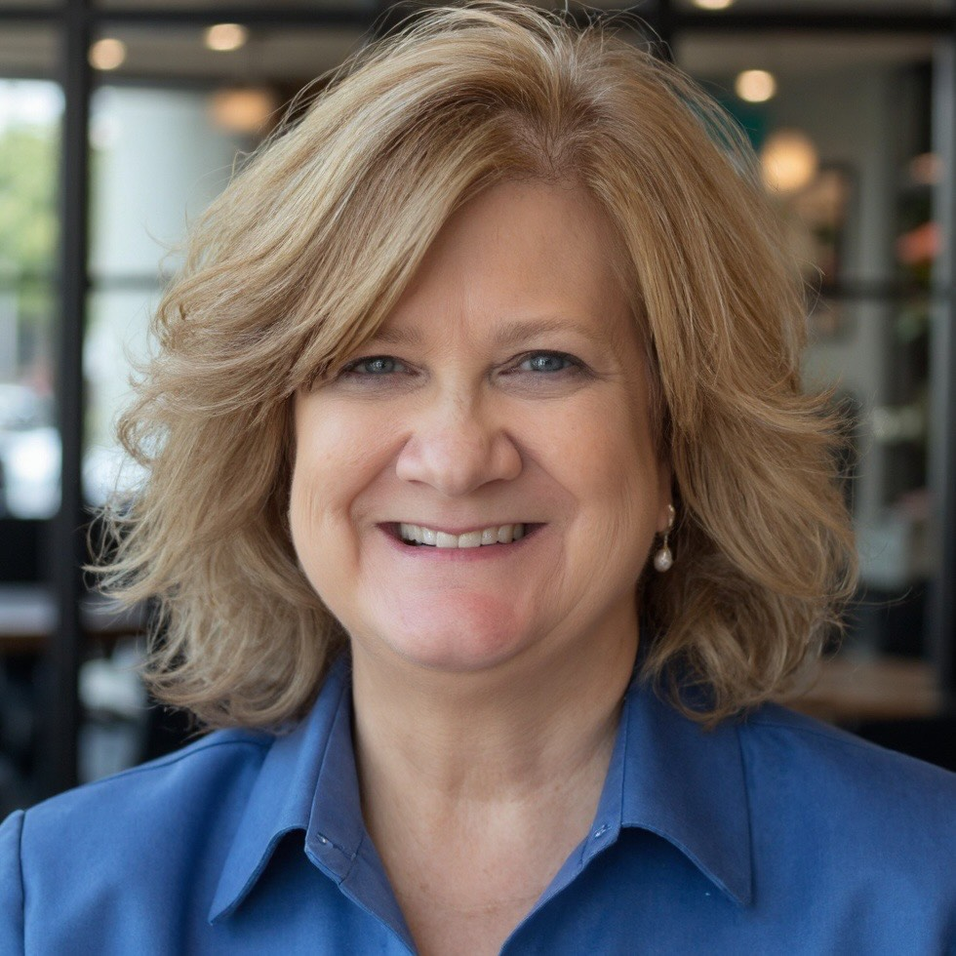
Revenue Diversification Strategies | Mary Beth McIntire
A passionate and strategic-minded executive, Mary Beth McIntire has advanced several organizations and led many initiatives to elevate mission and create positive change. As a trusted advisor, Mary Beth’s abilities to bring a team to consensus, solve a problem or direct key business initiatives have been demonstrated in her roles in the c-suite. Her past leadership of numerous nonprofit organizations demonstrate her strengths in board governance, program development, and fundraising where she has raised over $80 million for the benefit of others. She received her B.S. from James Madison University and her MBA from Virginia Commonwealth University. Mary Beth lives outside Richmond, Virginia with her husband Rob. They have two daughters and more importantly four grandchildren.

Slide 3

Session Goals
Notes:
Win the revenue game!!

Slide 4
Session Goals
Analyze existing revenue portfolios to determine where new opportunities exist.
Understand how to conduct a basic assessment to examine alternative funding sources and how they may or may not align with organizational mission and capacity.
Develop an initial action plan for implementing a diversified funding strategy that mitigates risk and supports

Slide 5
TYPES OF FUNDING SOURCES
WHY IS IT IMPORTANT?
DONATIONS
EARNED INCOME
EVENTS
GRANTS
ENDOWMENT
  Government Grants (local, state, national)
  Private Foundations
  Corporate Grants
  Individuals
  Major Gifts
  Online Fundraising
  Crowdfunding
  Social Enterprises
  Fee-for-Service Programs
  Product Sales
  In-kind donations
  Event sponsorships
  Tickets sales
  Auctions, Runs, Galas
  Third party events
  Building an endowment fund
  Special Project Funds
Notes:
Who has all 5?

Slide 6
EFFECTIVE RESOURCE DEVELOPMENT
  Top 3 Revenue Sources (by %):
  Most Fragile Revenue Source:
  Most Reliable Revenue Source:
  Risk Question:
    If our largest source dropped by 25%, what would be most affected?
CURRENT REVENUE SNAPSHOT

Slide 7
EFFECTIVE RESOURCE DEVELOPMENT
FUNDING DIVERSIFICATION
WHY IS IT IMPRTANT?
  Generating revenue from multiple sources to reduce dependence on any single funding stream
  Minimizes risks associated with fluctuations in funding.
  Creates a stable financial base for program expansion.
  Key to financial sustainability and risk management for nonprofits.
  Enables innovation and flexbility in program delivery.

Slide 8
EFFECTIVE RESOURCE DEVELOPMENT
  Financial Resilience: Protects from unexpected funding cuts.
  Increased Stability: A steady cash flow from different sources leads to operational stability.
  Enhanced Credibility: Diverse funding sources demonstrate support by a wide range of stakeholders.
  Opportunity for Innovation: Different funding streams allow for creative and innovative program development.
ADVANTAGES OF DIVERSIFICATION

Slide 9
EFFECTIVE RESOURCE
DEVELOPMENT
  DEVELOP PLAN OF DIVERSIFICATION
    ANALYSIS of current streams of revenue
    EVALUATE which stream to target first
    DEVELOP short term & long-term goals
Strategies for Diversifying Funding

Slide 10
EFFECTIVE RESOURCE
DEVELOPMENT
  Start social enterprises
  or fee-based services.
  Offer specialized training
  Offer consulting services
BE INNOVATIVE

Slide 11
EFFECTIVE RESOURCE
DEVELOPMENT
EXPLORE CORPORATE PARTNERSHIPS
    Align with corporations that share
    your values
    Develop corporate sponsorship
    opportunities, including cause
    marketing.
.

Slide 12
EFFECTIVE RESOURCE DEVELOPMENT
BUILD AN ENDOWMENT FUND
    Start with planned giving or major gifts.
    Manage investments for long-term sustainability.

Slide 13
EFFECTIVE RESOURCE
DEVELOPMENT
  DEVELOP PLAN FOR A SPECIFIC SOURCE
    How does a new source fit within your
    mission?
    What new relationships may be needed?
    What is the board’s role in development?
    What is the staff’s role in development?
    What data is needed for this new source?
Strategies
for Diversifying Funding

Slide 14
EFFECTIVE RESOURCE DEVELOPMENT
  Administrative Capacity:
    Diversifying funding streams requires strong financial management and human resources.
  Mission Drift:
    Beware of taking on funding that forces the organization to move away from its core mission.
  Sustainability:
    Ensure new funding sources align with the long-term goals of the nonprofit.
RISKS AND CONSIDERATIONS

Slide 15
EFFECTIVE RESOURCE DEVELOPMENT
Case Study A: Steady Steps Toward Stability
Organization: BrightPath Youth Services
Mission: After‑school and mentoring programs for rural middle‑school students
Primary Risk: 60% of revenue tied to a single federal grant
Case Study B: Busy, Broke, and Burned Out
Organization: Community Roots Housing Alliance
Mission: Housing stabilization and tenant advocacy
Primary Risk: Heavy reliance on contracts and a major event
DIVERSIFICATION CASE STUDIES

Slide 16
EFFECTIVE RESOURCE DEVELOPMENT
Case Study
Questions

Slide 17
EFFECTIVE RESOURCE DEVELOPMENT
  Purpose:
    Clarify priorities, manage risk, and identify realistic next steps
  Time Horizon:
    12–24 months (with 90-day actions)
  Sections Covered:
    Current Revenue Snapshot
    Strategic Diversification Goal
    Revenue Portfolio Alignment
    Diversification Ladder
    90-Day Action Commitments
    Board & Staff Roles
REVENUE DIVERSIFICATION ROADMAP

Slide 18
EFFECTIVE RESOURCE DEVELOPMENT
  Our Primary Diversification Objective:
    Reduce reliance on one source
    Increase unrestricted revenue
    Improve predictability/cash flow
    Support growth of priority programs
  In 2 Years, Success Looks Like:
STRATEGIC DIVERSIFICATION GOAL

Slide 19
EFFECTIVE RESOURCE DEVELOPMENT
Revenue Source | Mission Fit | Capacity Fit
    Grants
    Individuals
    Events
    Earned Income
    Corporate
  Revenue We Should Strengthen:
  Revenue We Should Be Cautious About Adding:
REVENUE PORTFOLIO ALIGNMENT

Slide 20
EFFECTIVE RESOURCE DEVELOPMENT
  Where Are We Now? (Pick One)
    Stabilizing existing revenue
    Improving predictability
    Adding adjacent revenue
    Innovating new revenue
  Our Next Realistic Rung:
  Key Capacity Gap Holding Us Back:
DIVERSIFICATION LADDER

Slide 21
EFFECTIVE RESOURCE DEVELOPMENT
  Strengthen This Revenue Source:
    First Action:
    Owner (Board/Staff):
  Test or Explore This Revenue Source:
    Small Pilot or Test:
    Success Indicator:
90-DAY ACTION COMMITMENTS

Slide 22
EFFECTIVE RESOURCE DEVELOPMENT
BOARD & STAFF ROLES
  Board Will Contribute By:
    Opening doors / introductions
    Policy or risk oversight
    Fundraising leadership
    Strategic decision-making
  Staff Will Contribute By:
    Execution & operations
    Data & analysis
    Relationship management
    Program alignment

Slide 23
EFFECTIVE RESOURCE DEVELOPMENT
  Funding diversification is critical for the financial health of nonprofits.
  A well-rounded funding strategy enhances resilience, flexibility, and impact.
  By investing in diverse sources, nonprofits can weather financial challenges while expanding their services.
KEY TAKEAWAYS

Slide 24
THANK YOU
KEY TAKEAWAYS
Mary Beth McIntire
marybethmcintire@gmail.com
804-513-4876

